Slide 1
CNN Based System Controller Using Hand Gestures
Guide: Team Members:
D. B. V. Ravi Sankar M.Saikiran Kumar(2451-16-737-046)
Associate Professor(ITD) D.Sai Pranav(2451-16-737-054)
G.Vamshi Krishna(2451-16-737-060)

Slide 2
Contents
Abstract
Existing System
Proposed System
Statement of Problem
Software requirements
Hardware requirements
Literature Survey
CNN Model
i)Layers of the model
ii) Illustration
Block Diagram
Implementation
Results
Future Scope
Conclusion

Slide 3
Abstract
Handling various devices around us needs abundant of mechanical work to be performed. To reduce this impact on the human beings we have designed a controller in which objects can be managed by hand gestures.
Hand gestures are very common in daily life, it is used as a medium of communication between people to describe any aspect. Thus, we have used this technique to control the objects in between us.
There are many other ways to control the devices but this method helps human to control the devices in a safe and comfortable user interface for diverse applications.

Slide 4
Existing System
Nowadays we are operating our home appliances
Manually which is a lot of time taking process and
there is also a risk in the task to control the devices(short circuit and electric shocks), waste of human effort due to that there is a lot wastage of power and we need to go near to the appliances to operate them.

Slide 5
Proposed System
As the title suggests that our project is going to detect the hand gestures of human to control the devices. To help devices to do various activities. Computers and computing devices are becoming an essential part of our lives day by day. The increasing demand for such computing devices increased the necessity of easy and practical computer interfaces.

Slide 6
Statement of Problem
Hand gestures have become very common form of communication in the real world.This project uses the human hand gestures to control the devices in the world.
There are many other ways to control the devices but this method helps humans to control the devices in a safe and comfortable user interface for a diverse applications.

Slide 7
Software Requirements
Python
Tensor flow
Numpy
Arduino IDE

Slide 8
Hardware requirements
8GB RAM
Intel processor
Arduino uno
USB cable
Devices

Slide 9
Literature Survey
Title | Author | Algorithms
HOME APPLIANCE IDENTIFICATION FOR NILM SYSTEMS BASED ON DEEP NEURAL NETWORKS | Deyvison de Paiva Penha and Adriana Rosa Garcez Castro2 | Identification of residential equipments using deep neural networks.
Hand Gesture Recognition Using an Adapted Convolutional Neural Network with Data Augmentation | Ali A. Alani , Georgina Cosma, T.M McGinnity , Aboozar Taherkhani | Adapted Deep Convolutional Neural Network (ADCNN).
Hand Gesture Recognition with Convolution Neural Networks | Felix Zhan | Convolutional Neural Network.

Slide 10
MODULE FLOW CHART
Module 2
Dataset retrieval
Using dataset creation of CNN
Testing and
Training
Recognizer of Dynamic
images
Module 3
Hardware
implemen-
-tation
Module 1
Module 4

Slide 11
CNN Model
A specific kind of such a deep neural network is the convolutional network, which is commonly referred to as CNN or ConvNet. It's a deep, feed-forward artificial neural network.
CNNs specifically are inspired by the biological visual cortex. The cortex has small regions of cells that are sensitive to the specific areas of the visual field. This idea was expanded by a captivating experiment done by Hubel and Wiesel in 1962 .
In this experiment, the researchers showed that some individual neurons in the brain activated or fired only in the presence of edges of a particular orientation like vertical or horizontal edges.

Slide 12
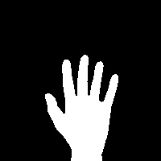

Working Of CNN
Convolution(Filtering the image)
Relu Layer
Pooling layer
Fully connected layer
CNN
5
CNN
0

Slide 13

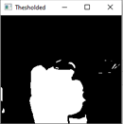
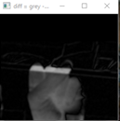
Convolution layer
Data set image
Dynamic image
-1 | -1 | -1 | -1 | -1
-1 | -1 | -1 | -1 | -1
-1 | 1 | 1 | 1 | -1
-1 | 1 | 1 | 1 | -1
-1 | 1 | 1 | 1 | -1
-1 | -1 | 1 | 1 | -1
-1 | -1 | -1 | -1 | -1
-1 | -1 | -1 | -1 | -1
-1 | -1 | 1 | 1 | -1
-1 | 1 | 1 | 1 | -1
-1 | 1 | 1 | 1 | -1
-1 | 1 | 1 | 1 | -1
-1:is an assumed pixel value at that position.
1: is an assumed pixel value at that position
y
x
Note: Computer sees an input image as array of pixels and it depends on the image resolution.
Eg: An image of 6x6x3 array of matrix of RGB(3 refers to RGB values).

Slide 14
1 | 1 | 1
1 | 1 | 1
(1 x1+1x1+1x1+1x1+1x1+1x1) 1
6
-1 | -1 | -1 | -1 | -1
-1 | -1 | -1 | -1 | -1
-1 | 1 | 1 | 1 | -1
-1 | 1 | 1 | 1 | -1
-1 | 1 | 1 | 1 | -1
-1 | -1 | 1 | 1 | -1
1
1 | 1 | 1
-1 | 1 | 1
0.66
1
1.By adding and multiplying corresponding pixel
values from the region were the hand gesture is spread.
1 | 1 | 1
1 | 1 | 1
1 | 1 | 1
0.66 | 1 | 1
1 | 1 | 1
1 | 1 | 1
1 | 1 | 1
1 | 1 | 1
1 | 1 | 1
-1 | 1 | 1
0.66 | 0.66 | 0.66
-0.57 | 0.66 | 0.57
0.7 | 0.66 | -0.66
-0.66 | 0.66 | 0.66
1 | 1 | 1
-1 | 1 | 1
Convolution layer output

Slide 15
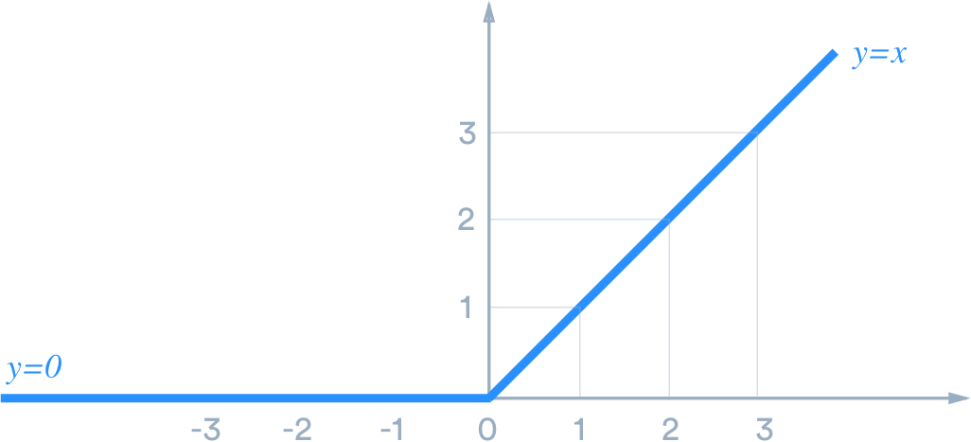
Relu Layer
Relu layer transform function only activates when an input is greater than 0 ,if
the input value is less than 0 than ouput is 0.
0, x<0
x, x>=0
f(x)
RELU
function
RELU
function
1 | 1 | 1
1 | 1 | 1
1 | 1 | 1
0.66 | 1 | 1
1 | 1 | 1
1 | 1 | 1
1 | 1 | 1
0.66 | 1 | 1
0.66 | 0.66 | 0.66
-0.57 | 0.66 | 0.57
0.7 | 0.66 | -0.66
-0.66 | 0.66 | 0.66
0.66 | 0.66 | 0.66
0 | 0.66 | 0.57
0.7 | 0.66 | 0
0 | 0.66 | 0.66
f(x)
f(x)

Slide 16
Pooling layer
1.Pick a cell which is of 2 x 2 or 2x3.
2.Take a maximum value out of those cells (2x2 or 3x3).
1 | 1 | 1
1 | 1 | 1
1 | 1 | 1
0.66 | 1 | 1
1 | 1 | 1
1 | 1 | 1
0.66 | 0.66 | 0.66
0 | 0.66 | 0.57
0.7 | 0.66 | 0
0 | 0.66 | 0.66
0.66 | 0.66 | 0.66
0.70 | 0.66 | 0.66
Output after passing through
pooling layer

Slide 17
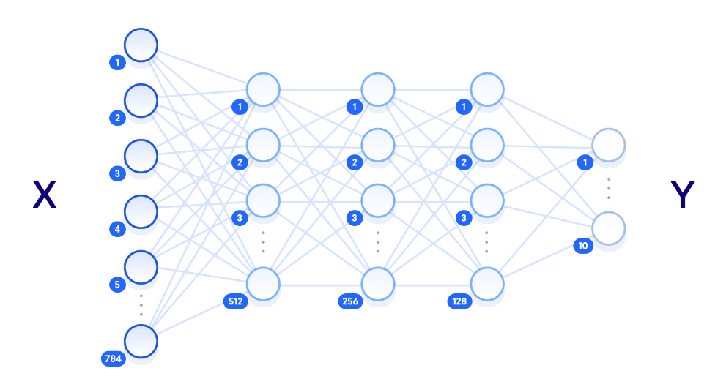
-1 | -1 | -1 | -1 | -1
-1 | -1 | -1 | -1 | -1
-1 | 1 | 1 | 1 | -1
-1 | 1 | 1 | 1 | -1
-1 | 1 | 1 | 1 | -1
-1 | -1 | 1 | 1 | -1
Convolution
Relu function
Pooling
Convolution
Relu function
Pooling
1 | 1
1 | 1
0.66 | 0.66
1 | 0.66
After performing multiple times of the convolution, relu and pooling layer, we reduce the spatial size of the original image.As you can see the original image is shrinked to a size from 6x5 to 2x2(30 cells to 8 cells).

Slide 18
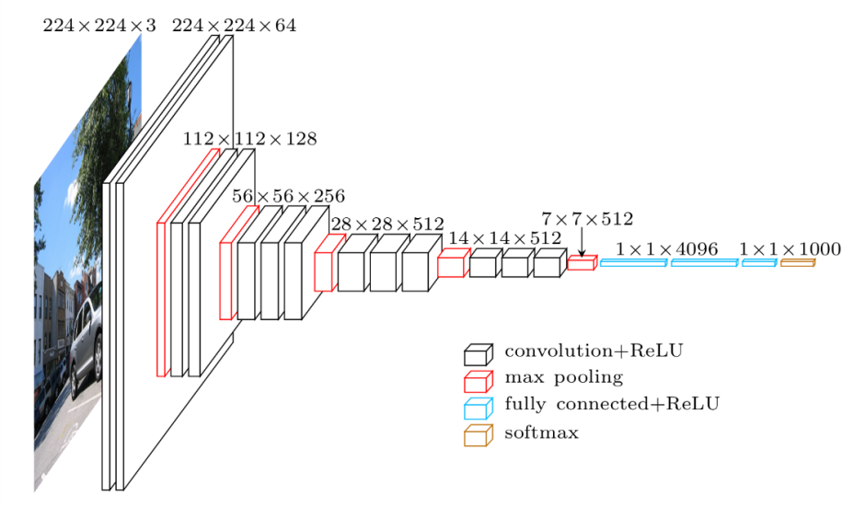
On Original Image
224x 224 x3(150528 neurons or cells)
is reduced to 1x1x1000(1000 cells).

Slide 19
Fully Connected Layer
This is the final classification layer were the stacking up of filtered images into a
single list takes place.
1
1
1
1
0.66
0.66
1
0.66
0.66
0.75
1
0.66
0.66
0.66
0.7
0.7
1 | 1
1 | 1
0.66 | 0.75
1 | 0.66
0.66 | 0.66
1 | 0.66
0.66 | 0.66
0.70 | 0.70
Zero finger image
Five finger image

Slide 20
Illustration
Data trained images
Input image
1
0.66
0.57
1
0.56
0.66
0.66
0.7
0.7
1
1
1
1
0.66
0.66
1
0.66
1
1
1
0.66
0.66
0.56
1
0.76
3
5
7
0.75
0.915
0.90

Slide 21
Arduino uno
Arduino is an open-source electronics platform based on easy-to-use hardware and software. Arduino boards are able to read inputs - light on a sensor, a finger on a button, or a Twitter message - and turn it into an output - activating a motor, turning on an LED, publishing something online.
The Arduino Software (IDE) runs on Windows, Macintosh OSX, and Linux operating systems. Most microcontroller systems are limited to Windows.

Slide 22
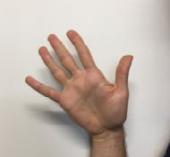
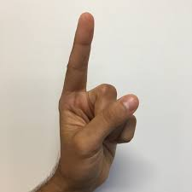
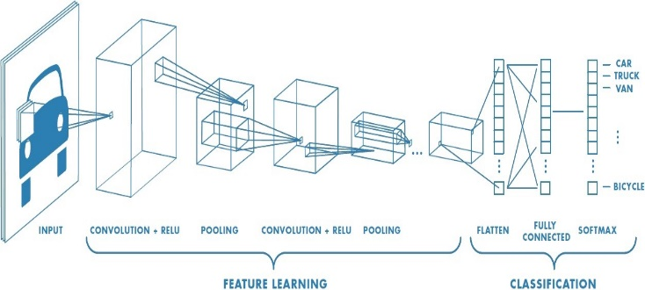
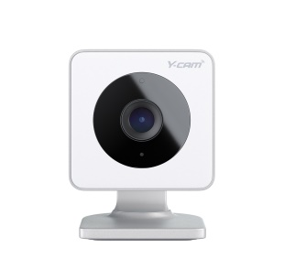
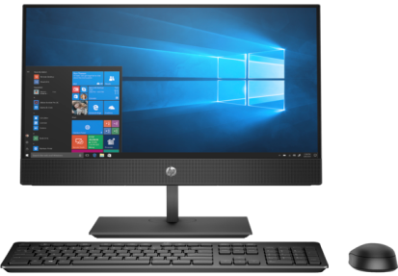
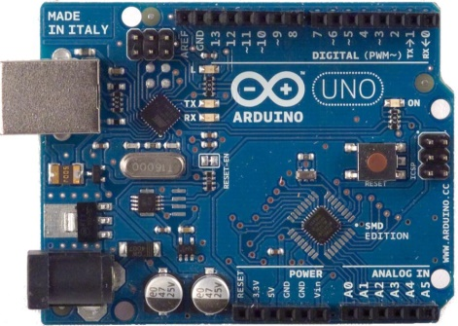
Block Diagram
Home appliances

Slide 23
Implementation
In this project we are designing a classifier by providing training data of various hand gestures which is available and some part of dataset is used for testing our model.
After getting the accuracy more than 80% then the model is ready for the use.
We are providing the images to our model from webcam which will detect the hand gestures given by the person

Slide 24
Implementation
Based on the output of the model we are connecting the model to the arduino in which we are implementing the program to what to happen when a particular output is arrived from the model.
The home appliances are connected to arduino which will be operated based on the output that is arrived from our model .

Slide 25
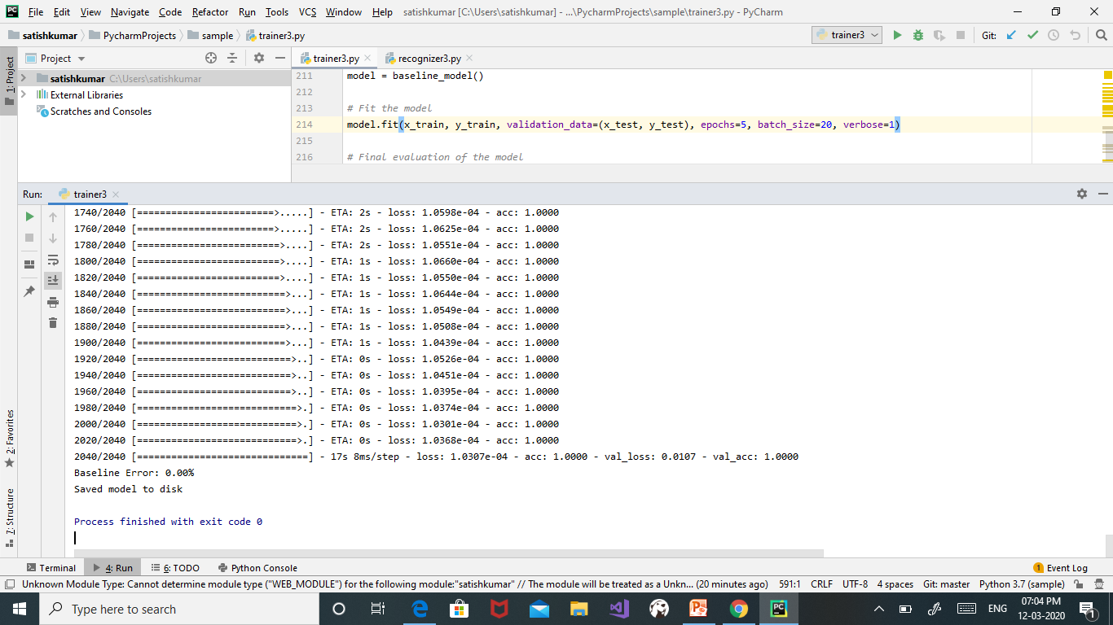
Results

Slide 26
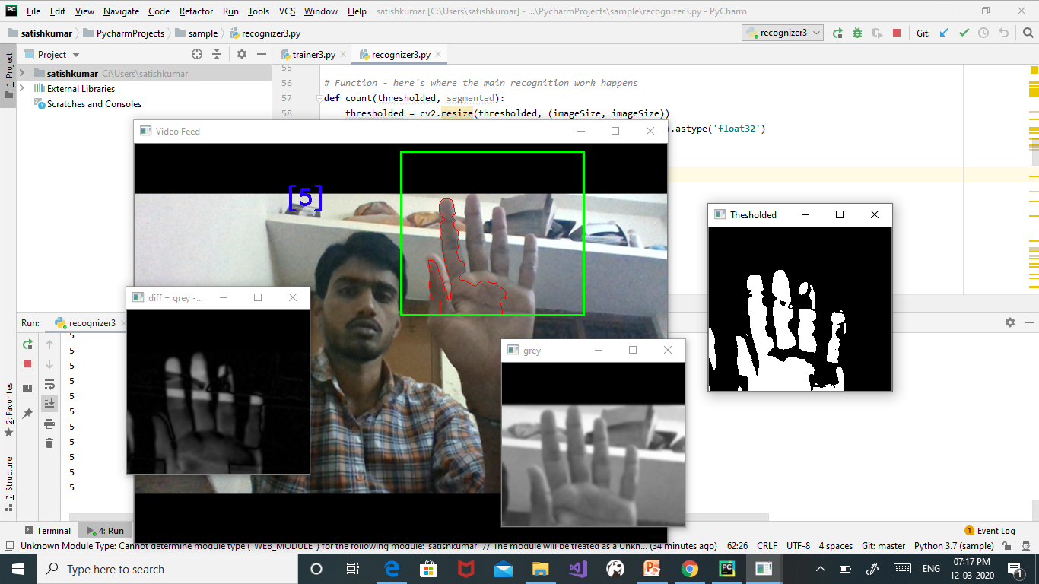
Results

Slide 27
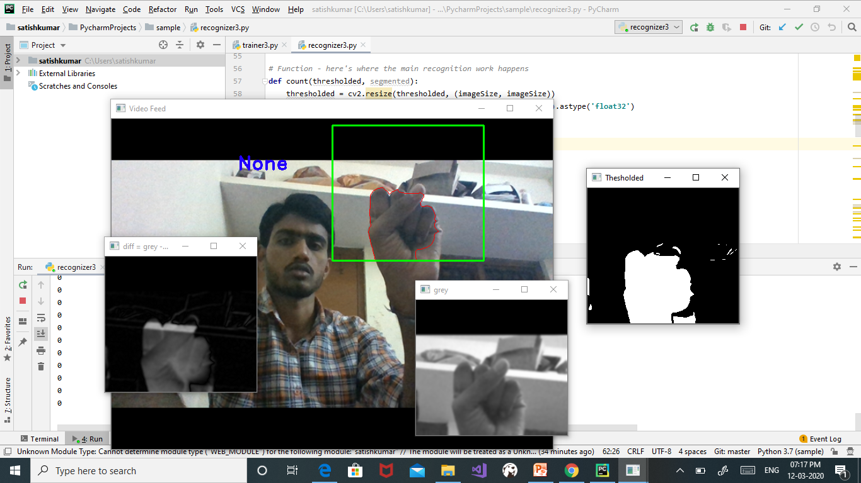
Results

Slide 28
Applications
It helps to improve the standard of living.
It helps the person to operate anything from the long distances.
It helps to operate any home appliances from anywhere.

Slide 29
Future Scope
In this project,we are negotiating only two labels so that only one device can be handled with this application.To enforce more devices we can expand the classes to any number and control any number of devices with this application.
Here, we are only controlling the devices using one static device(PC)to send the inputs but in future if we expand to google cloud storage system, with any system we can send the inputs and control the devices.

Slide 30
Referrences
https://ieeexplore.ieee.org/document/8843453
https://towardsdatascience.com/training-a-neural-network-to-detect-gestures-with-opencv-in-python-e09b0a12bdf1
https://www.internetsociety.org/resources/doc/2017/artificial-intelligence-and-machine-learning-policy-paper/?gclid=CjwKCAjw8ZHsBRA6EiwA7hw_sY0BzzlKqQ3xzSWCIReaaqtQ5WMjhkmg80ouH7iIhMDze7vJoCcBjRoCcaIQAvD_Bw
https://www.arduino.cc/en/guide/introduction

Slide 31
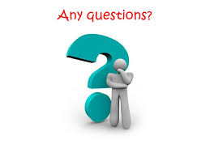

Slide 32


